Slide 1
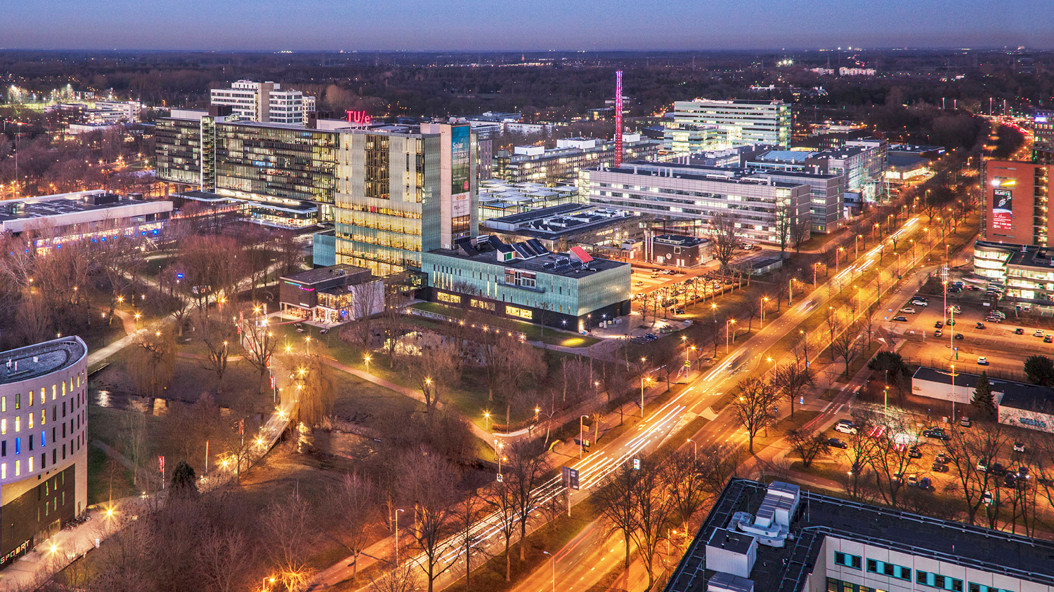
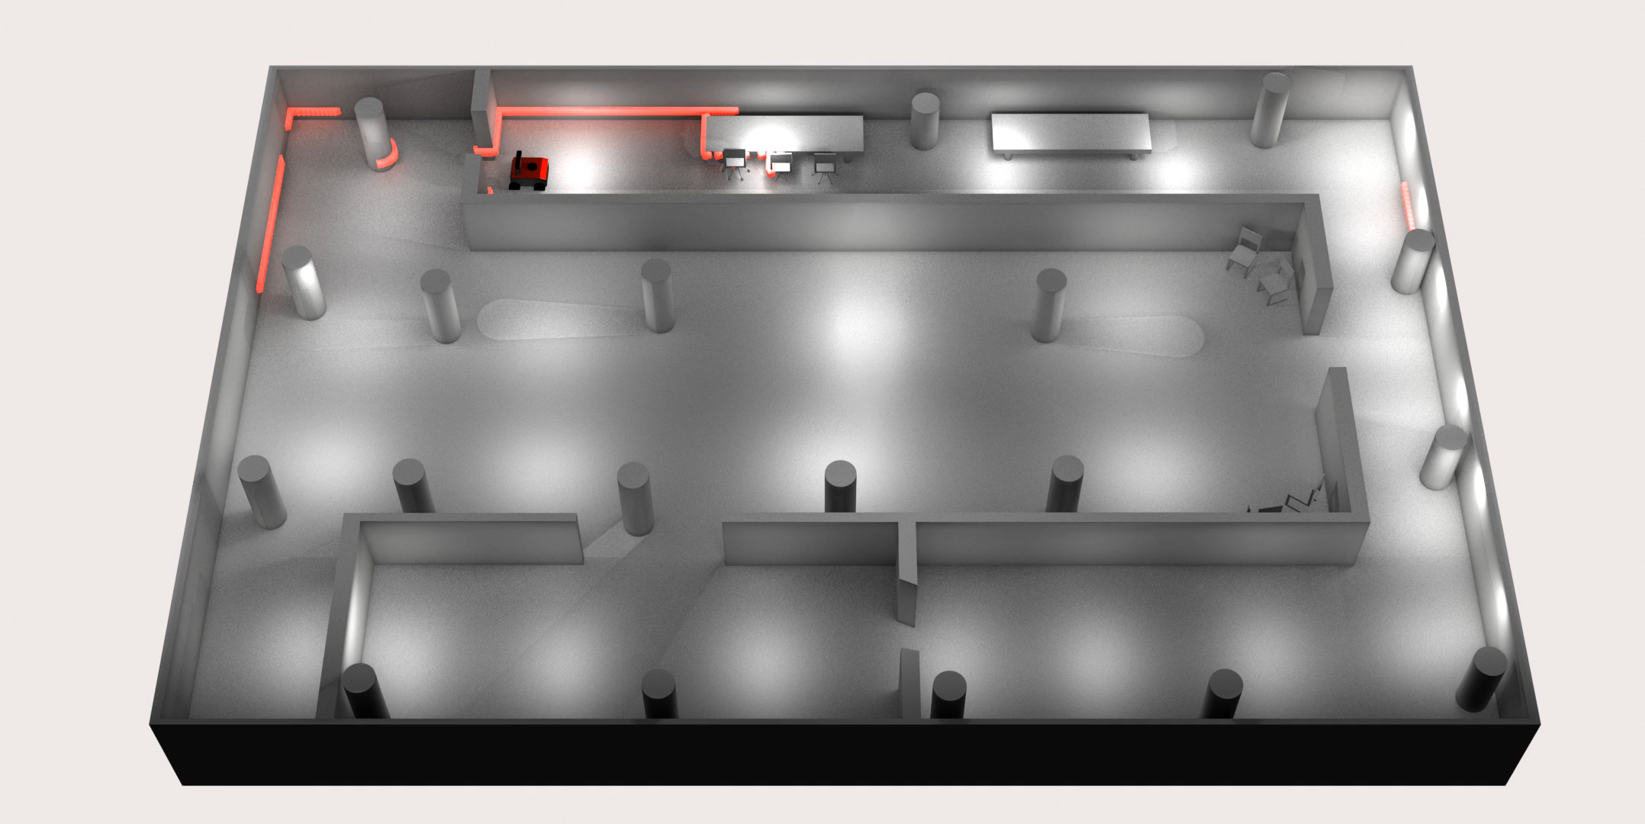
A Parametric Dataset Generator For Updating Digital Twins Through 2D LiDAR Perceptual Data
26th of September 2024
Pim van den Akker
Mechanical Engineering, Control Systems Technology Supervisors: Elena Torta, Gijs van Rhijn
Committee: Elena Torta, dr.,Jos Elfring, dr. ir., Pieter Pauwels, dr. ir

Slide 2

2D LiDAR
?
?
?
?
?
?
How can we provide additional information?
Problem Statement

Slide 3
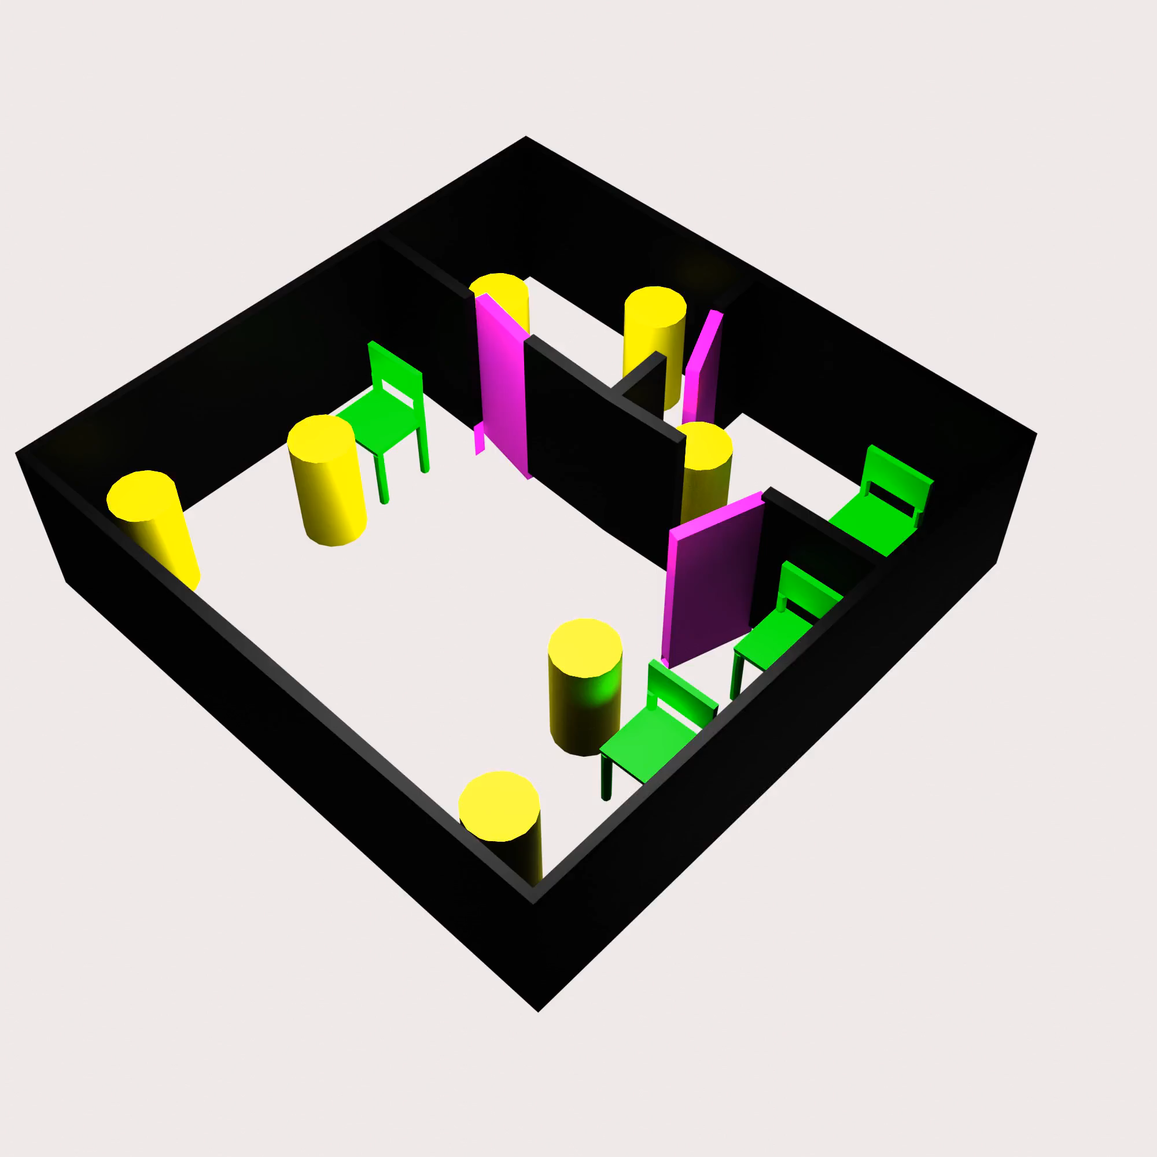
Building Information Model (BIM)
BIM Model
3D model made during building construction
Semantic (labelled) information
Readily available
Convert BIM to 2D map with labels
From BIM Initialize Digital Twin
Digital twin: an up-to-date representation of real world
Useful for robot navigation and object tracking
Chair
Wall
Pillar
Door
How do we keep the digital twin up to date?
Problem Statement

Slide 4
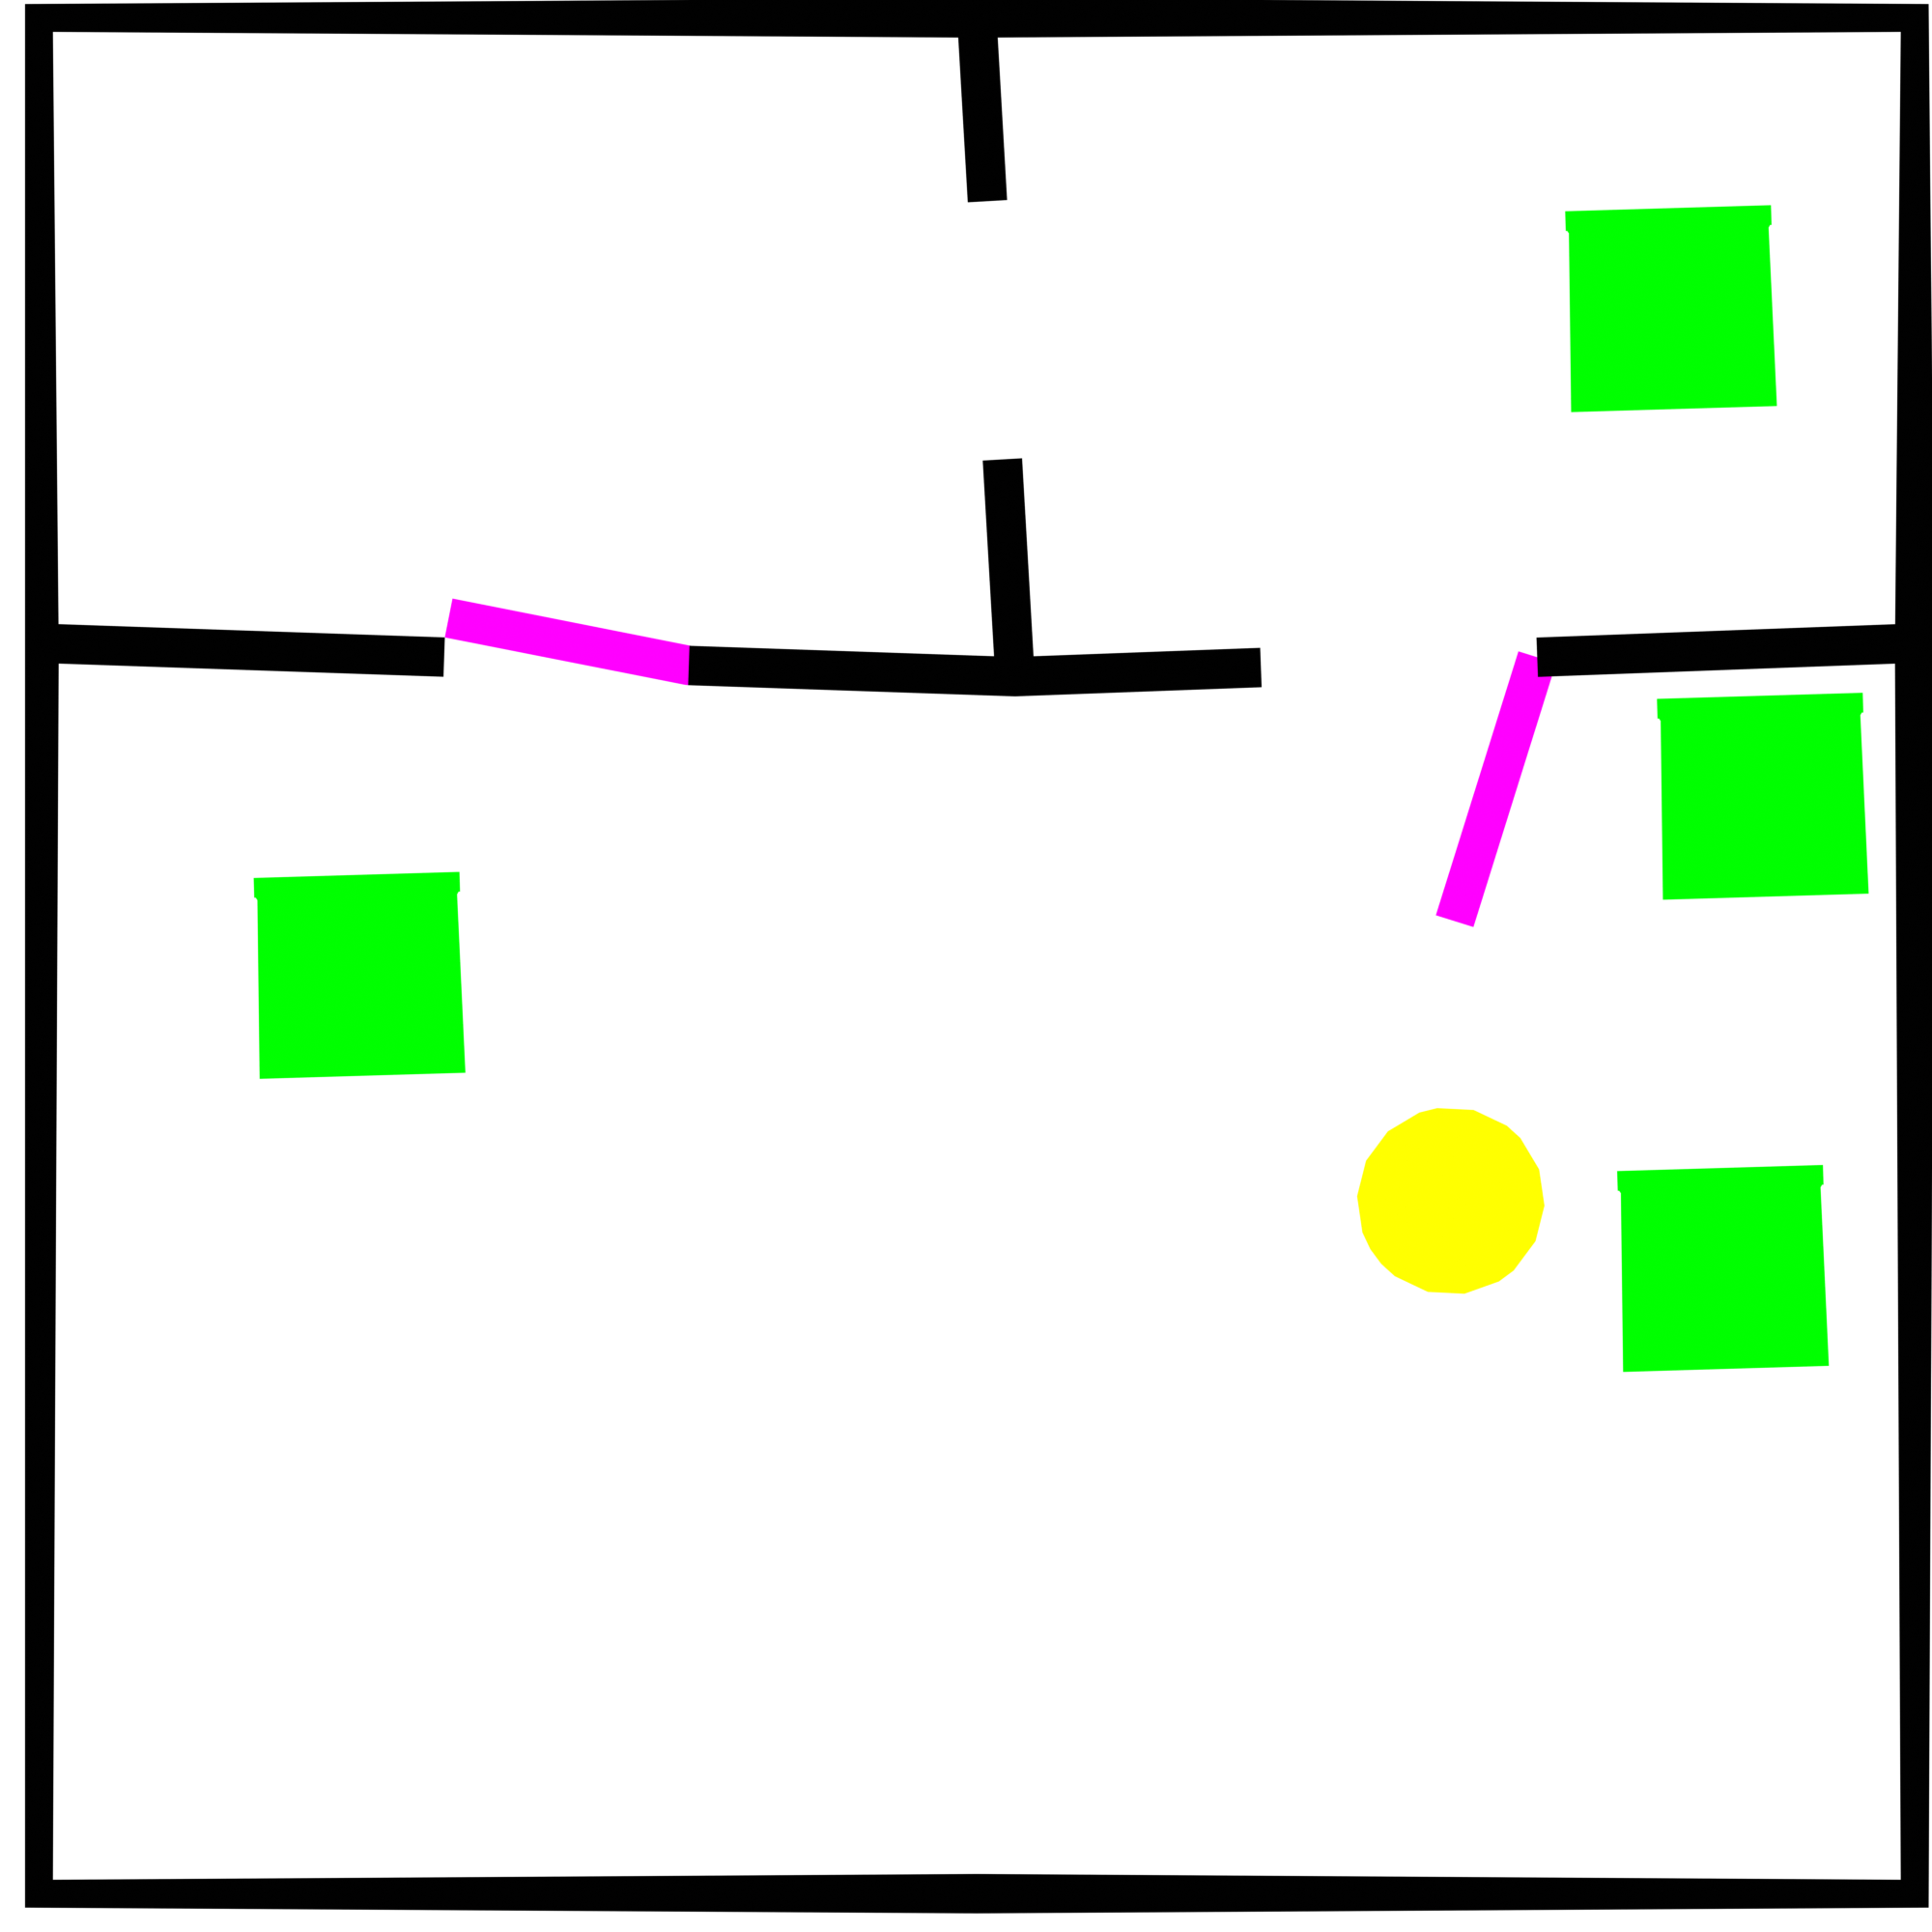
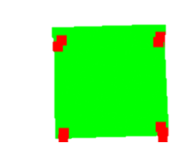


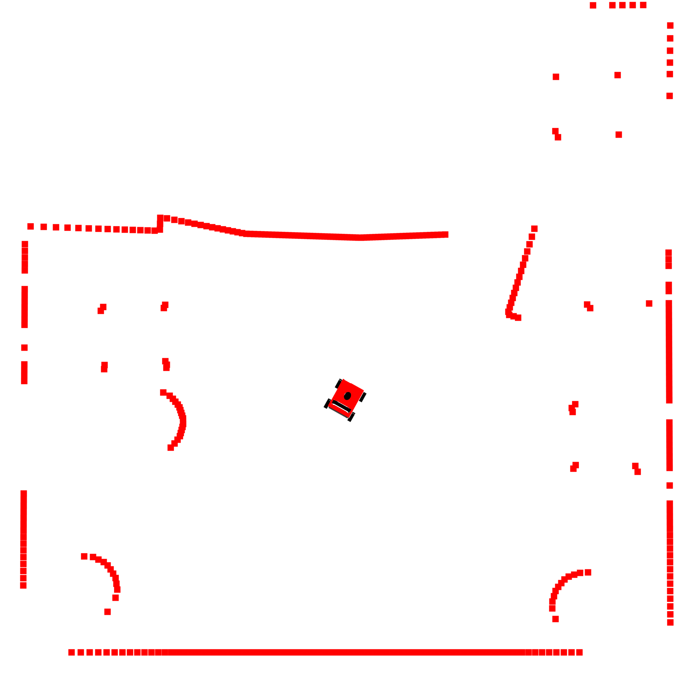
Updating Digital Twin
Prior Map (Digital Twin)
Combined
Real-World LiDAR data
Problem Statement

Slide 5
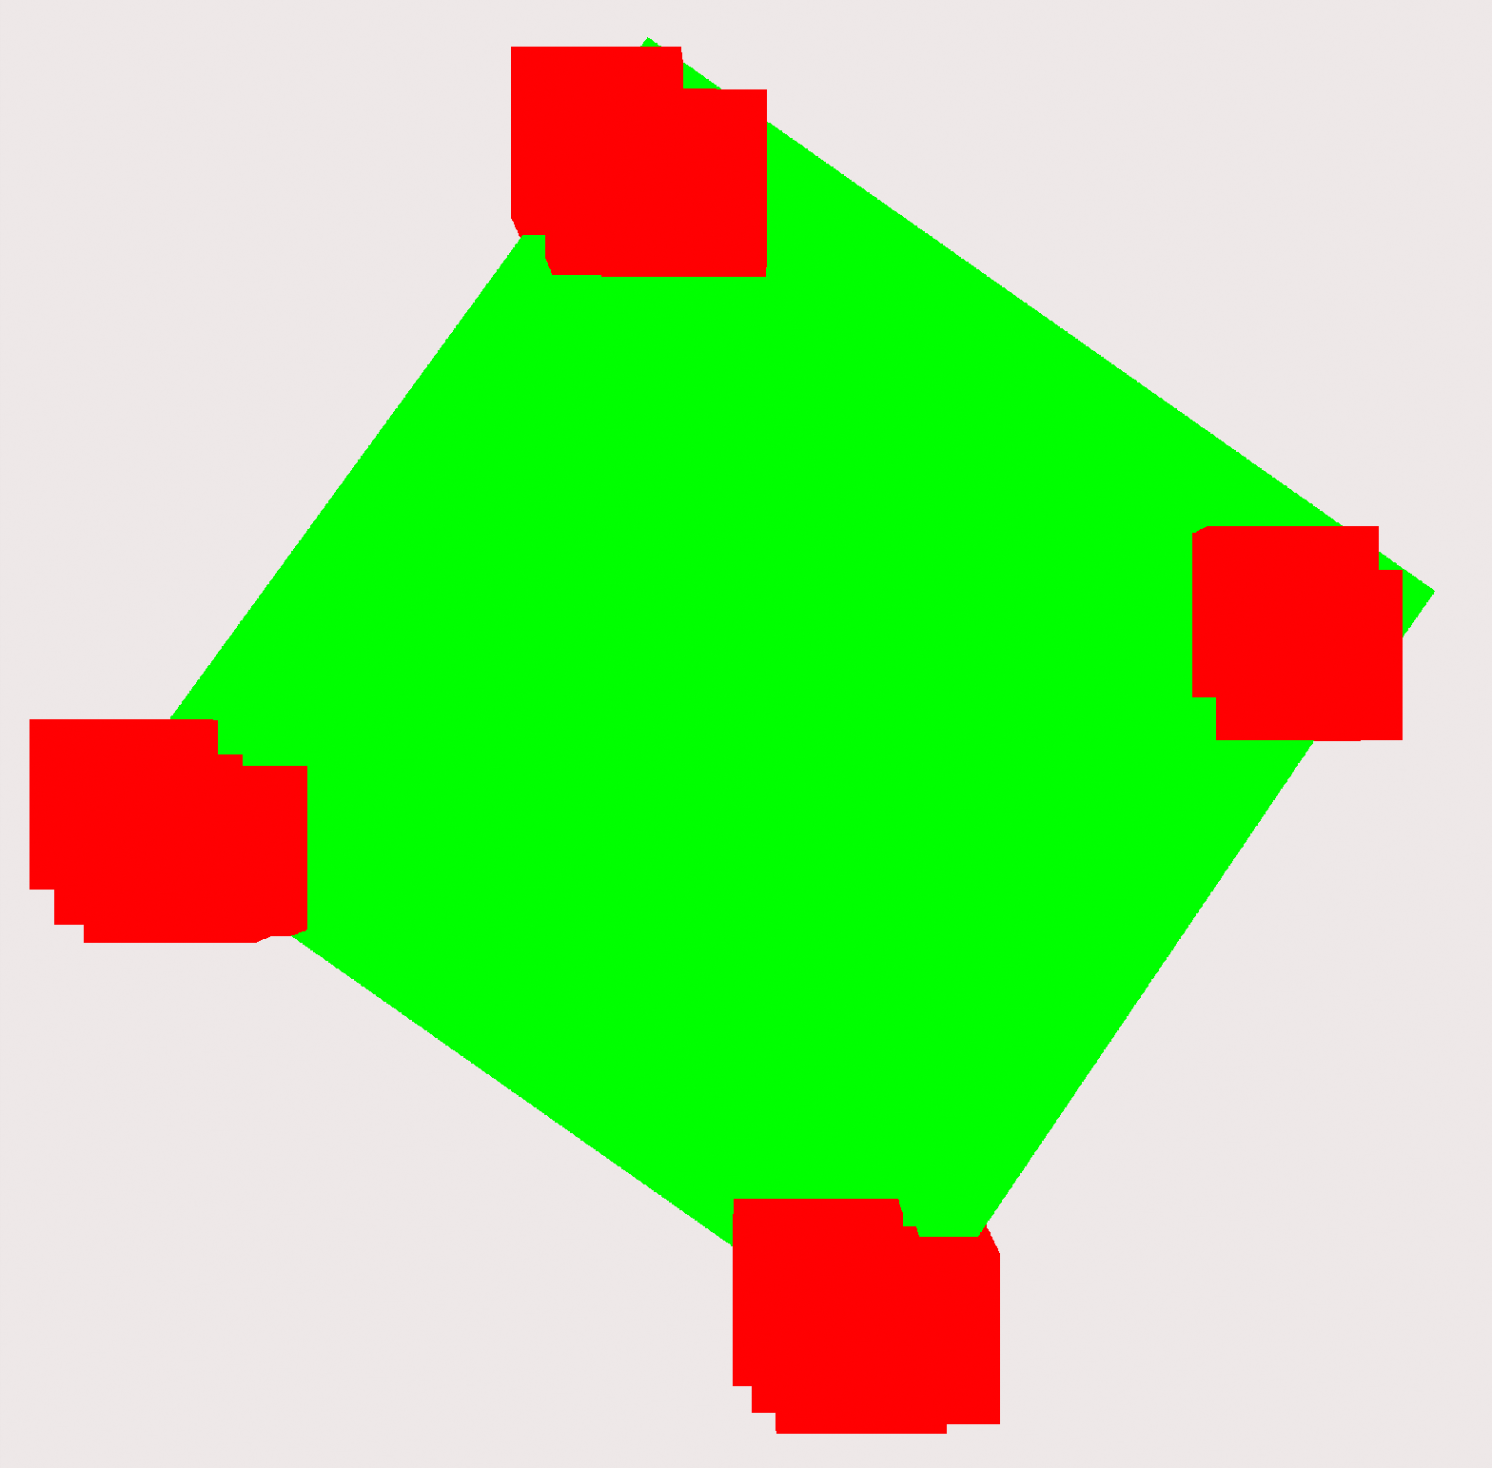
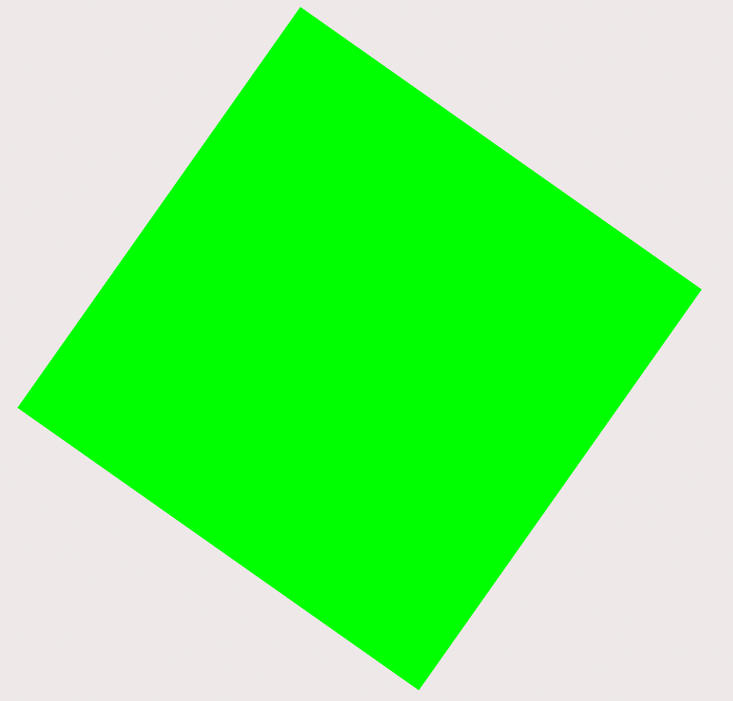
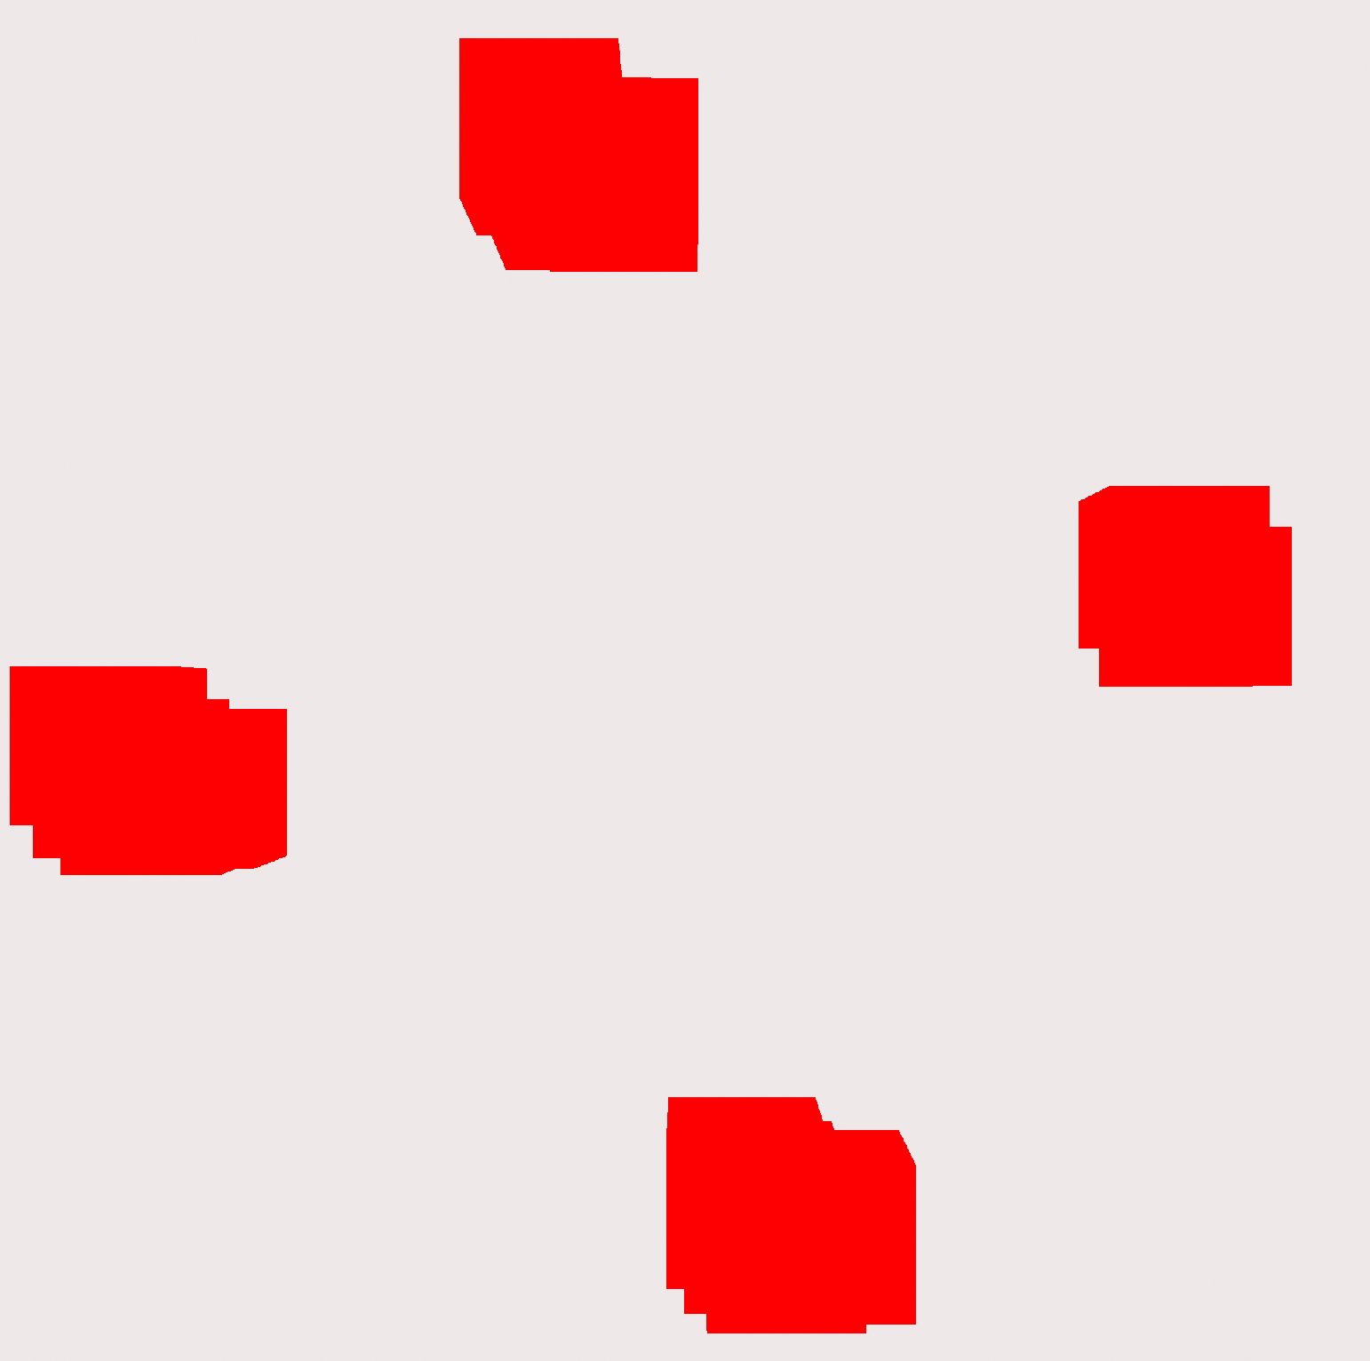
Digital Twin Mismatches
Correct Chair
Digital Twin
Real World
How to detect these mismatches automatically?
How to maintain semantics?
Our solution:
Train a computer vision model to detect the patterns
Train by giving examples
Removed Chair
New Chair
How do we get the data to train the model?
Problem Statement

Slide 6

Data Generation
Manually labelling real data
Computer generated (synthetic) data
Resources: capturing, labelling
Not much variety
A lot of time
Cheap, just compute time
A lot of data
As varied as your generator
Perfect annotation
Domain gap: Difference between synthetic and real world
Problem statement

Slide 7
Goals
Implement a computer vision model to detect mismatches
A parametric dataset generator that emulates the data representing a building’s digital twin and LiDAR
Making specific datasets for specific environments
Problem Statement

Slide 8
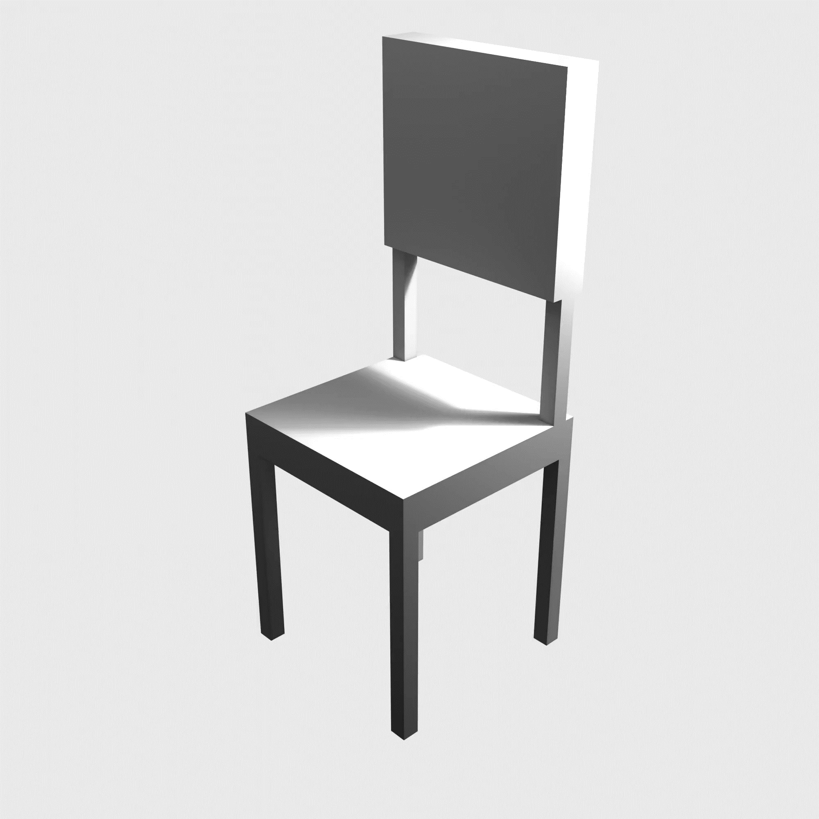
Parametric Dataset Generator
User defined data generation parameters
User controls the object dimensions
Specific objects for specific environments
Variety in data!
For machine learning robustness
Reduce domain gap
How do we generate varied environments?
Methods

Slide 9
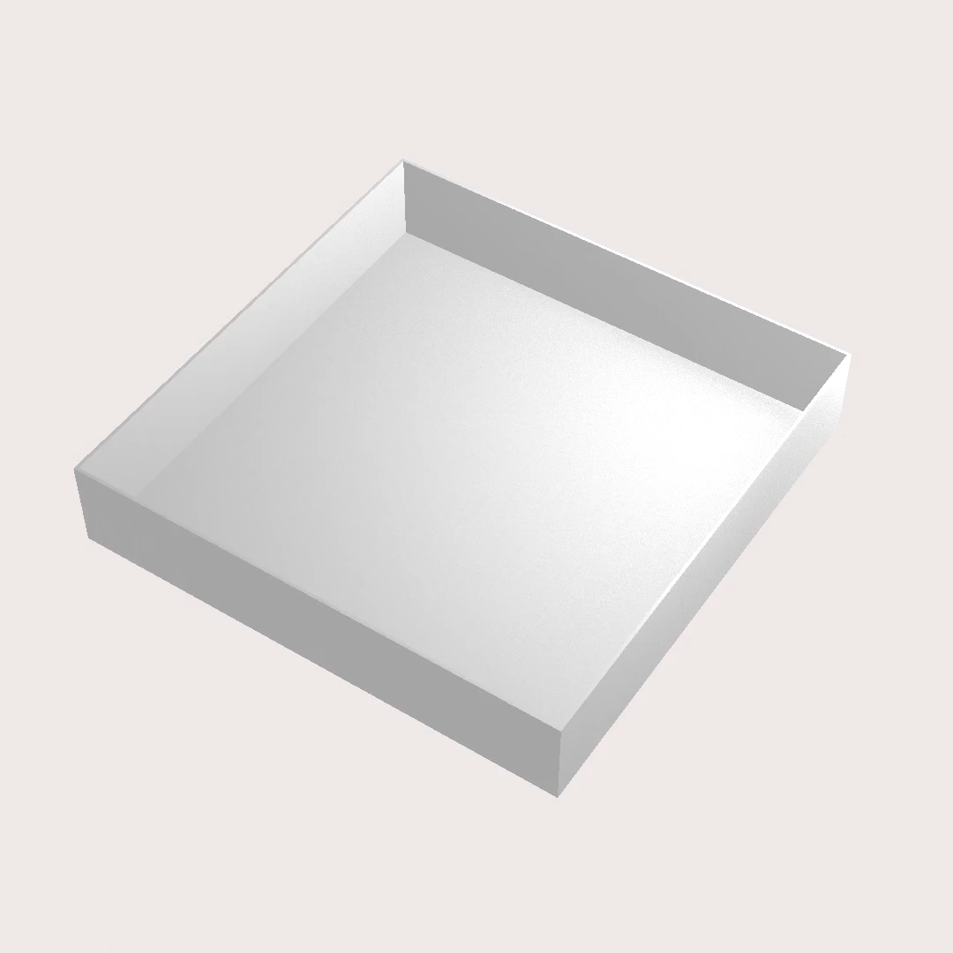
How do we simulate the “real world”?
Methods
Notes:
Random examples separate video

Slide 10
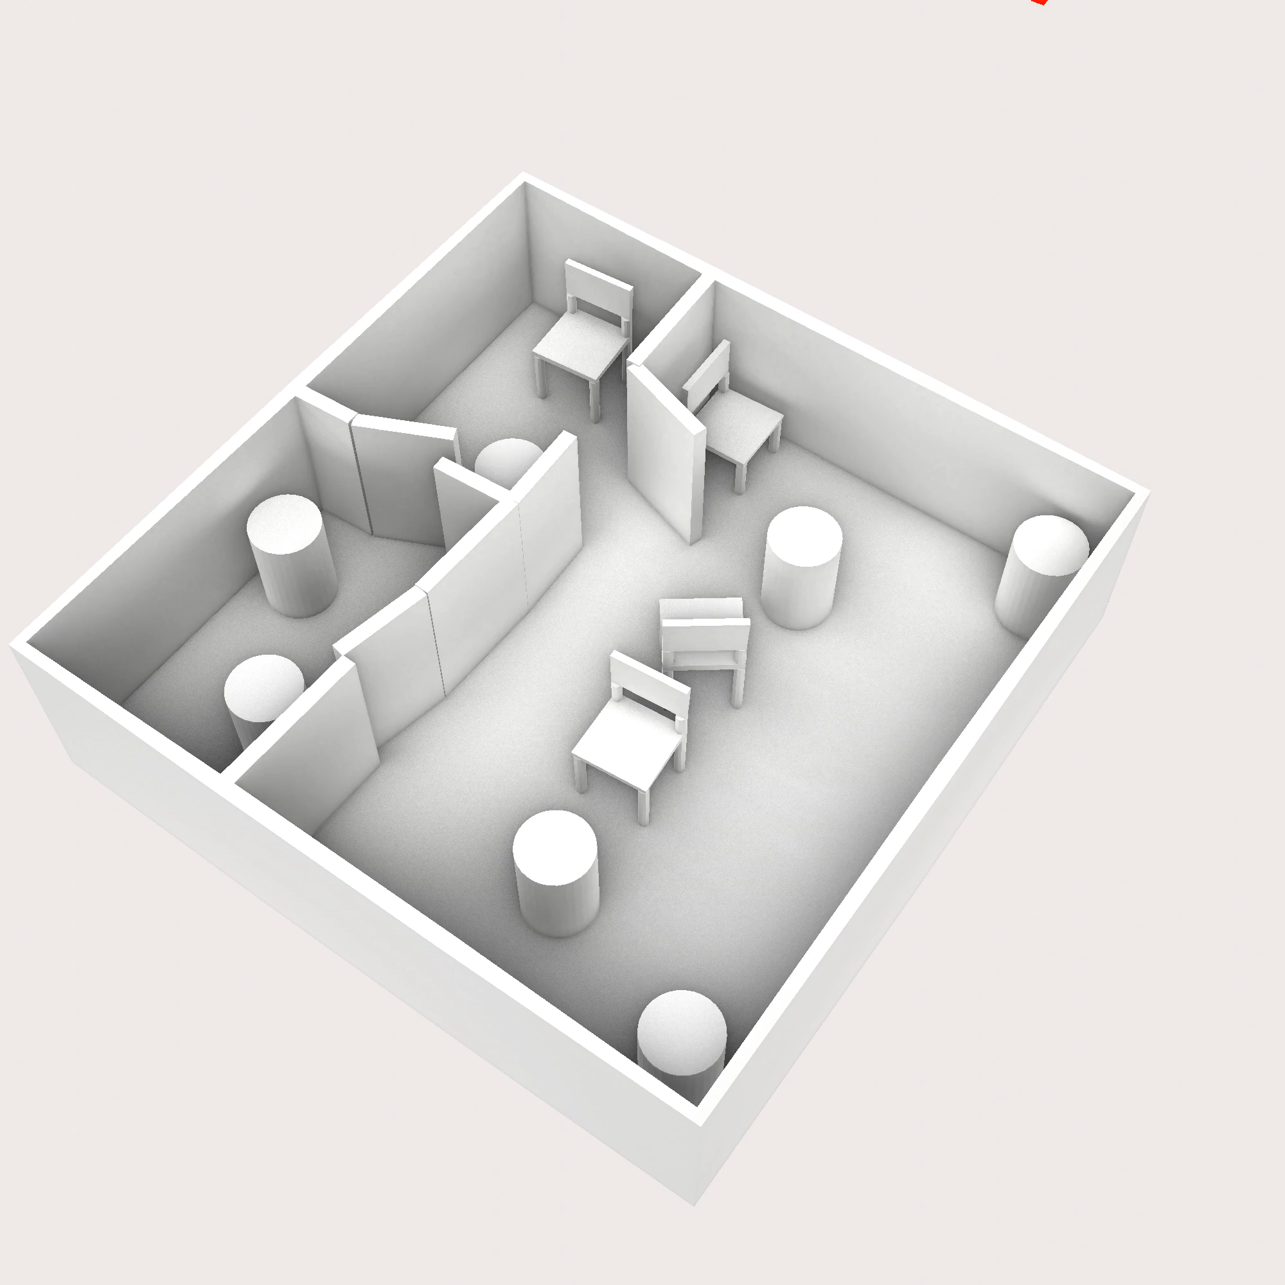
2D LiDAR Simulation
Simulation:
Generated environment
Noise
Noise types:
Sensor noise
Localization and sensor artifact noise
How do we use this to simulate mismatches?
Methods

Slide 11
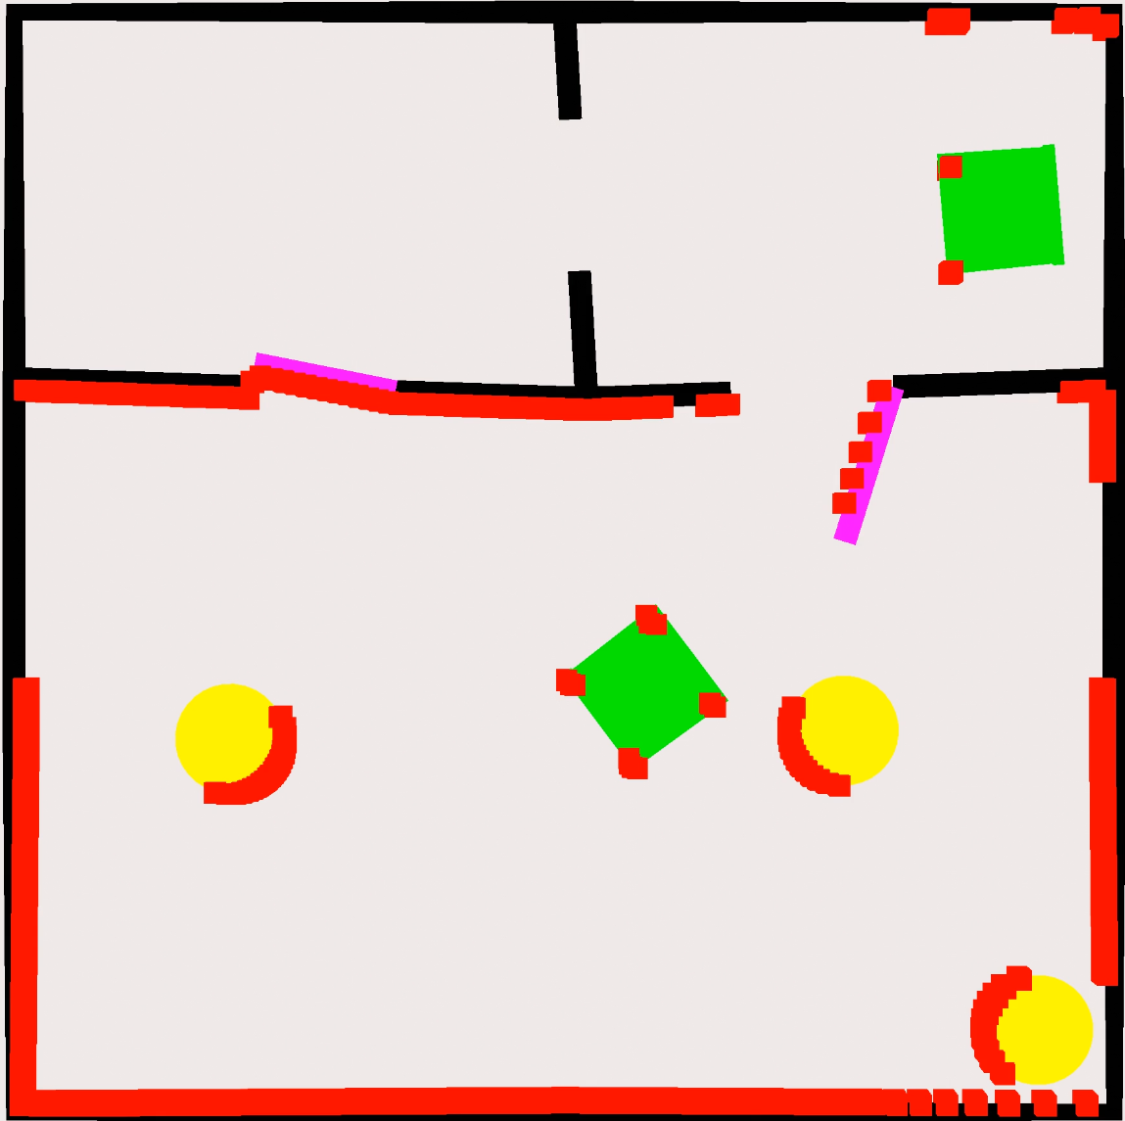
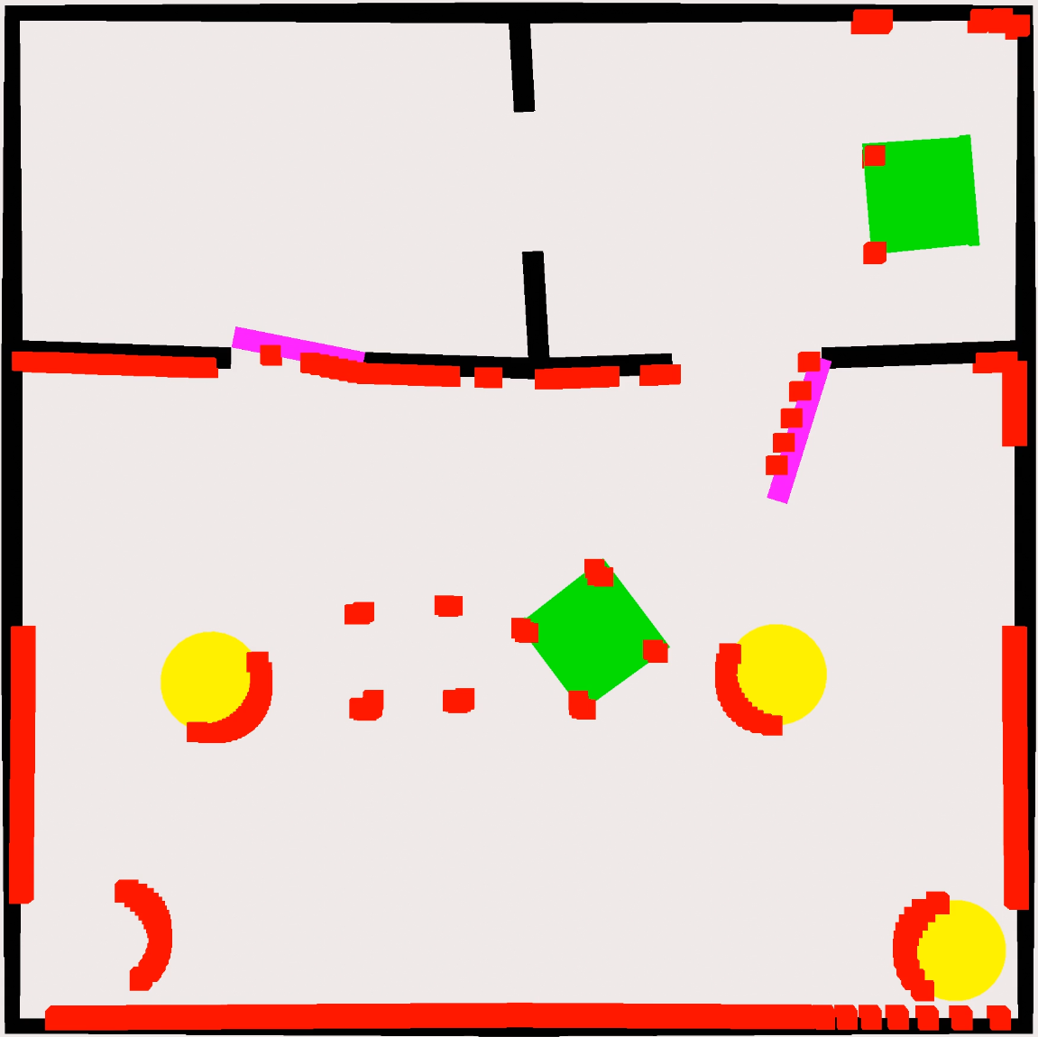
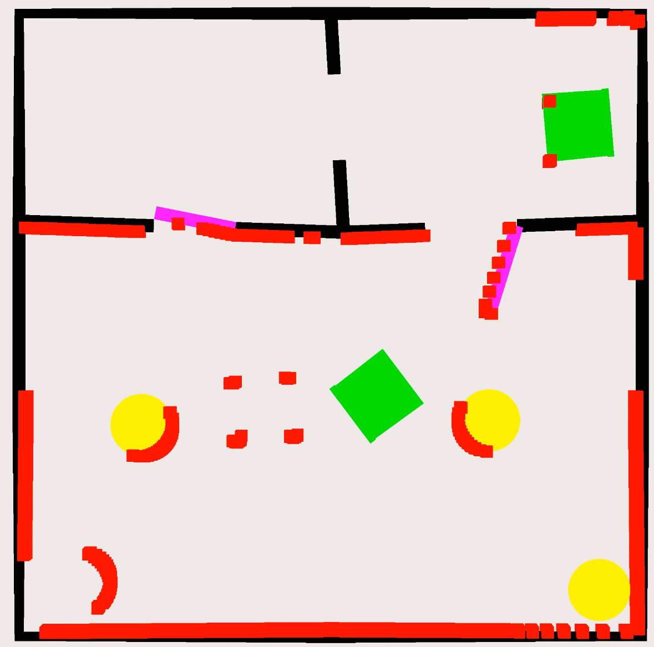
Generating The Mismatches
Starting Point
Add object with only LiDAR: New Object
Remove Digital Twin information: Removed Object
Classes: Correct Chair, Removed Chair, New Chair – Correct Pillar, Removed Pillar, New Pillar - Door
Methods

Slide 12
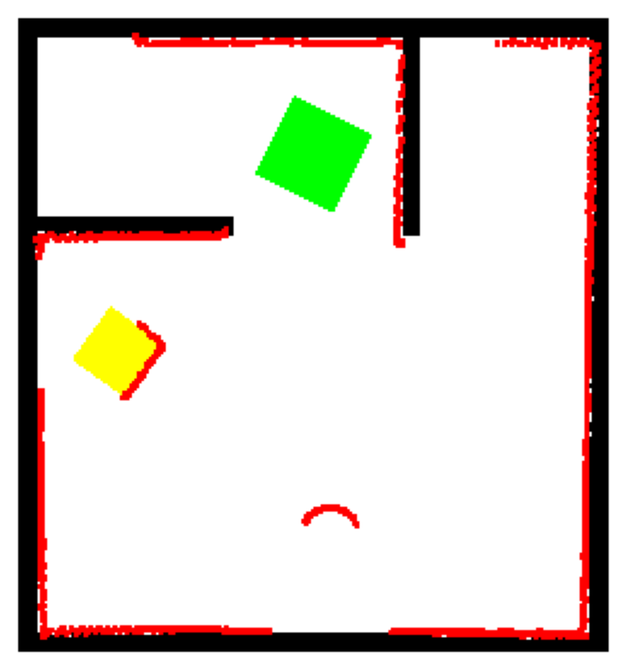


Computer Vision Model
Output/ground truth
Bounding boxes
Labels
Mask shape
Input image
Chair, Removed: 1
Chair, Removed 2
Instance segmentation model: Mask R-CNN
Pillar, Correct 1
Pillar, New 1
Methods
Notes:
Add colors to each type of output and match it with the image

Slide 13
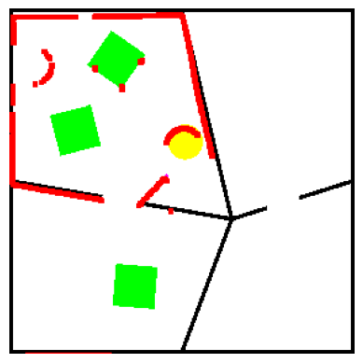
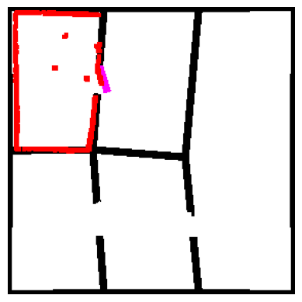
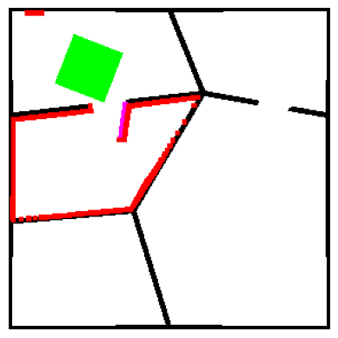
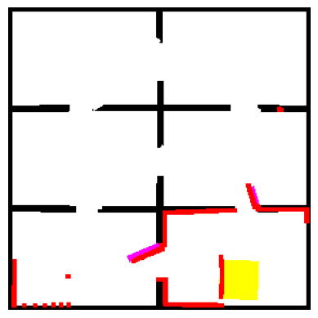
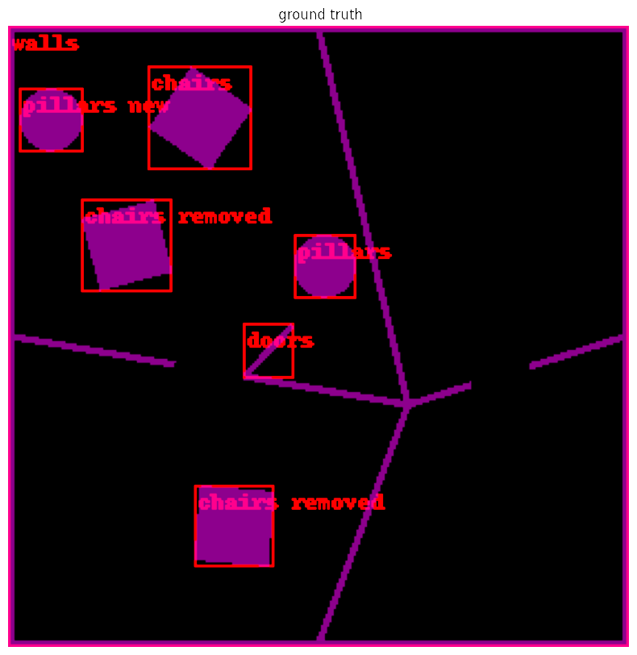
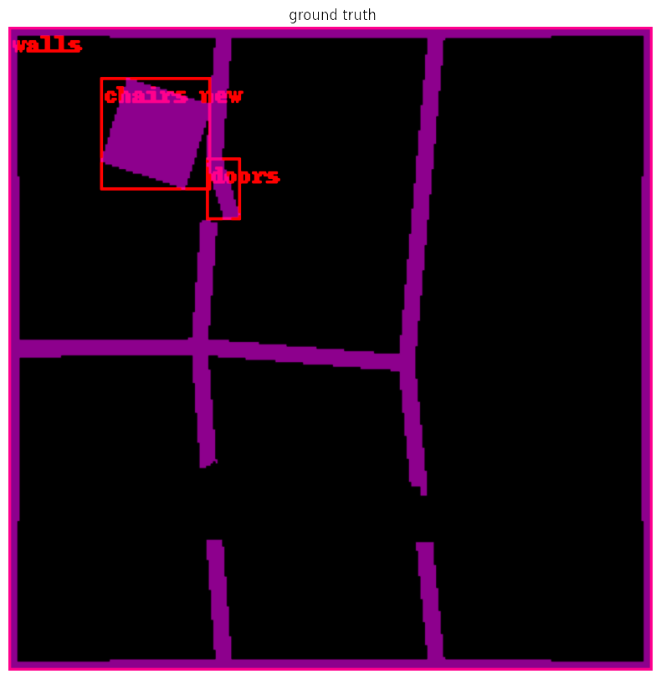
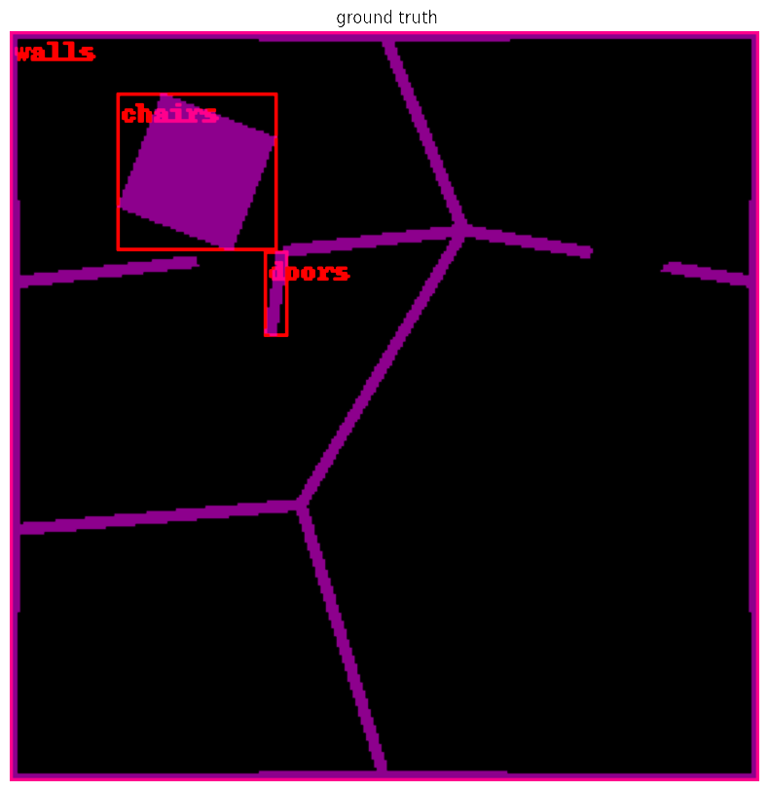
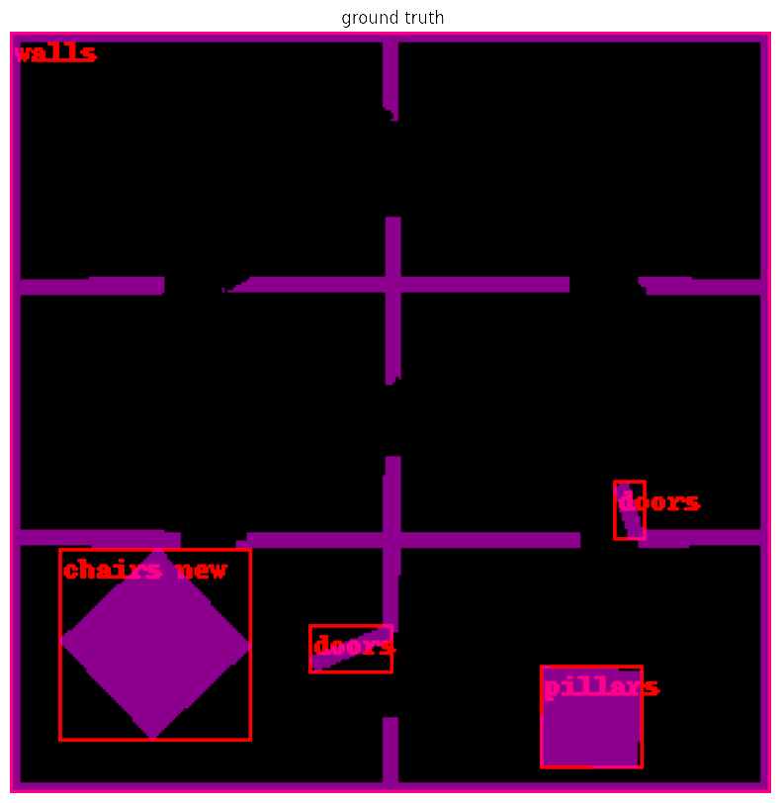
Generated Training Data
n = 1
n = 2
n = 3
n = 4000
…
Input
…
Ground truth
Does this represent the real world?
Methods

Slide 14
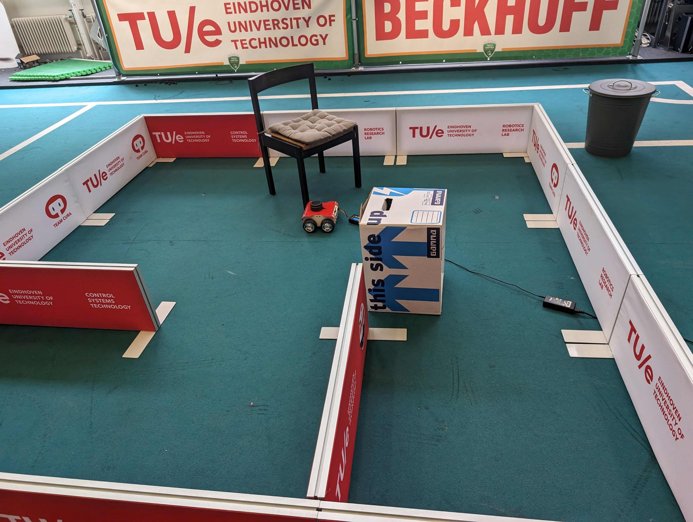



Real-World Test Dataset
120 hand labelled examples
Data not used in training
How does the model perform on the test set?
Methods

Slide 15

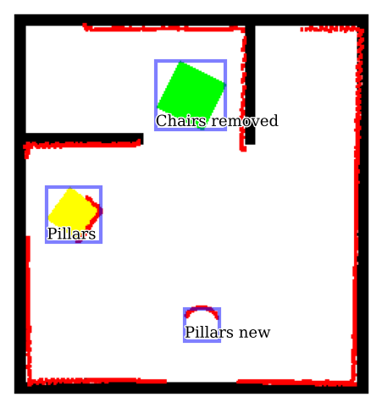
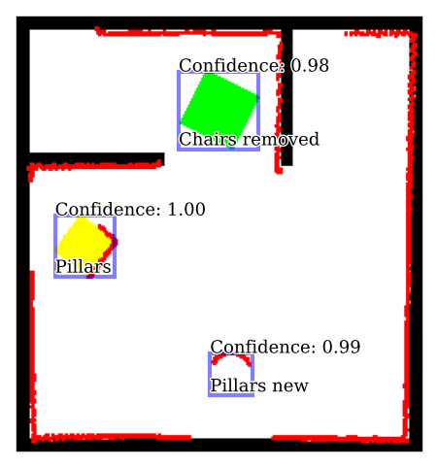
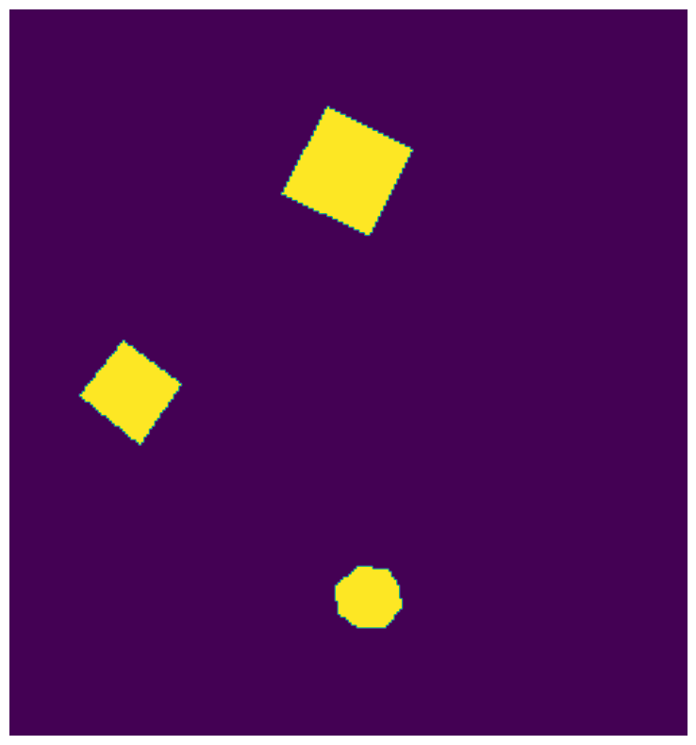

Qualitative Model Performance On Real World
Bounding Box Ground Truth
Bounding Box Model Prediction
Input Image
Mask Ground Truth
Mask Model Prediction
Shape completion!
It trains!
15
Methods
Notes:
It trains!

Slide 16
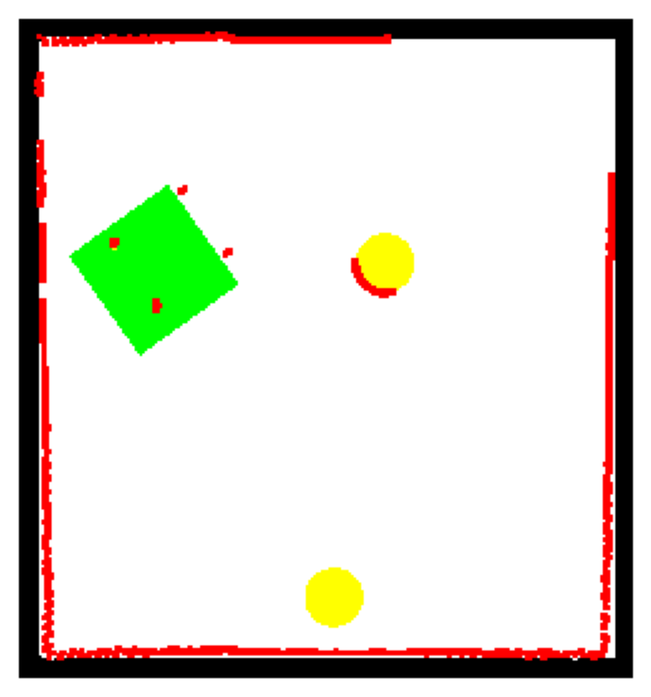
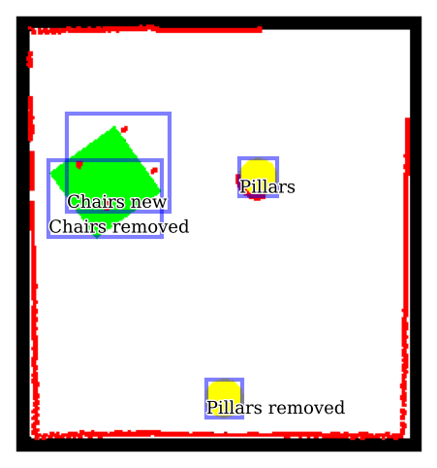
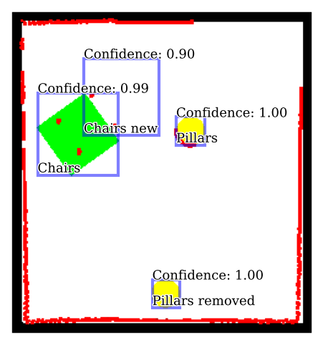


Qualitative Model Performance On Real World
Mask Ground Truth
Input Image
Bounding Box Ground Truth
Mask Model Prediction
Bounding Box Model Prediction
16
Results

Slide 17

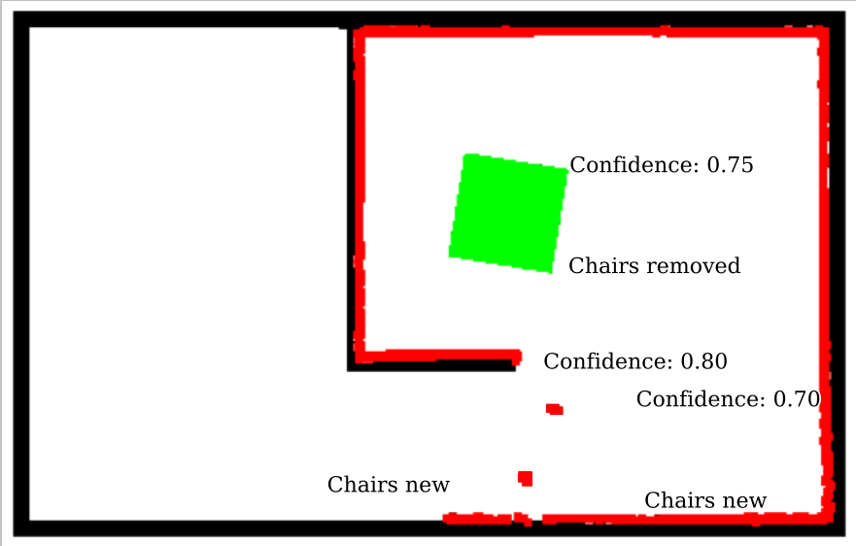
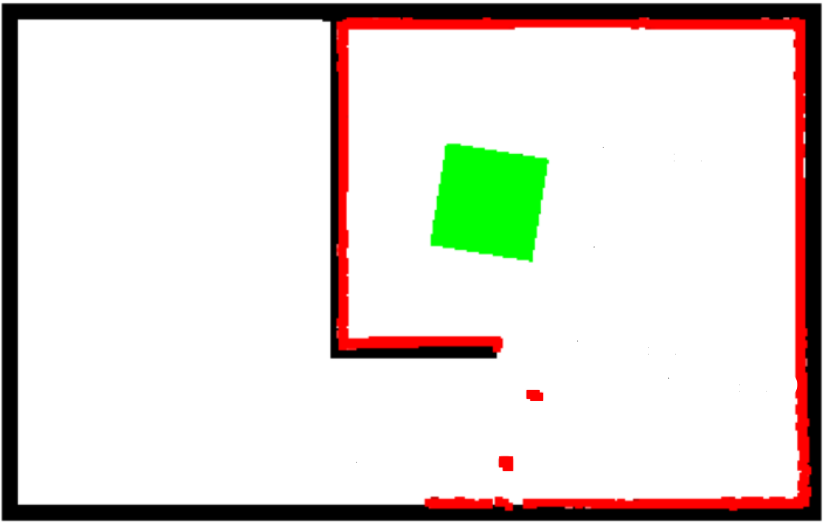
Overconfident predictions
Chair
LiDAR
Two overlapping wrong predictions
Inherent to the model
How do we mitigate this issue?
Find the area of overlap
Treat these areas as not dependable
Is this information useless?
No, make overlapping prediction a hypothesis
Hypothesis is correct if a predicted label corresponds to ground truth
Almost time for experiments!
Results

Slide 18

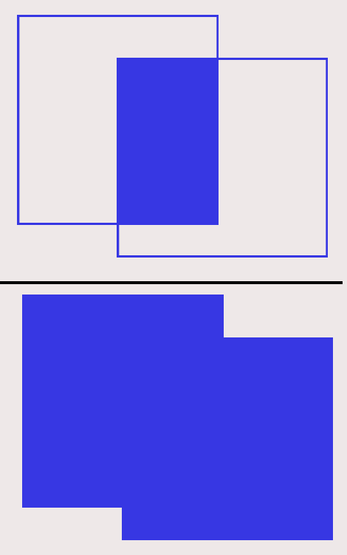
Metrics
Metric
mean Average Precision (mAP) | Measures detection across multiple thresholds.
True Positive Rate (TPR): | Proportion of positive instances correctly classified by the model.
Hypothesis TPR | TPR for hypothesis
Mask Intersection over Union (IoU) | Measuring mask accuracy
IoU =
Results

Slide 19
Experiment 1
Goal:
How does performance compare to the real-world vs synthetic data?
Methodology:
Test on the real world and synthetic dataset
Results
Notes:
Overview slide tussen de verschillende experiment slides

Slide 20
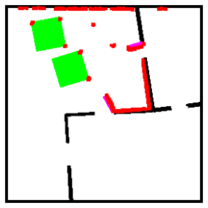


Experiment 1: Bounding box mAP
Mean average precision (mAP)
Input Image
Model Prediction
Domain gap
Results

Slide 21
Experiment 1 Results
Mean average precision (mAP)
There exists a “domain gap”
Mask IoU works better on real world data
Real World dataset easier than synthetic in some cases
Metric | True Positive Rate | Mask Intersection over Union | Hypothesis True Positive Rate
Real World Data | 0.80 | 0.86 | 0.93
Synthetic Data | 0.85 | 0.78 | 0.97
Results

Slide 22
Experiment 2
Goal:
Does making a customized dataset for a specific environment help?
Methodology:
Create and train on customized vs generalized dataset
Results
Notes:
Overview slide tussen de verschillende experiment slides

Slide 23
Experiment 2 Results Bounding box mAP
Results

Slide 24
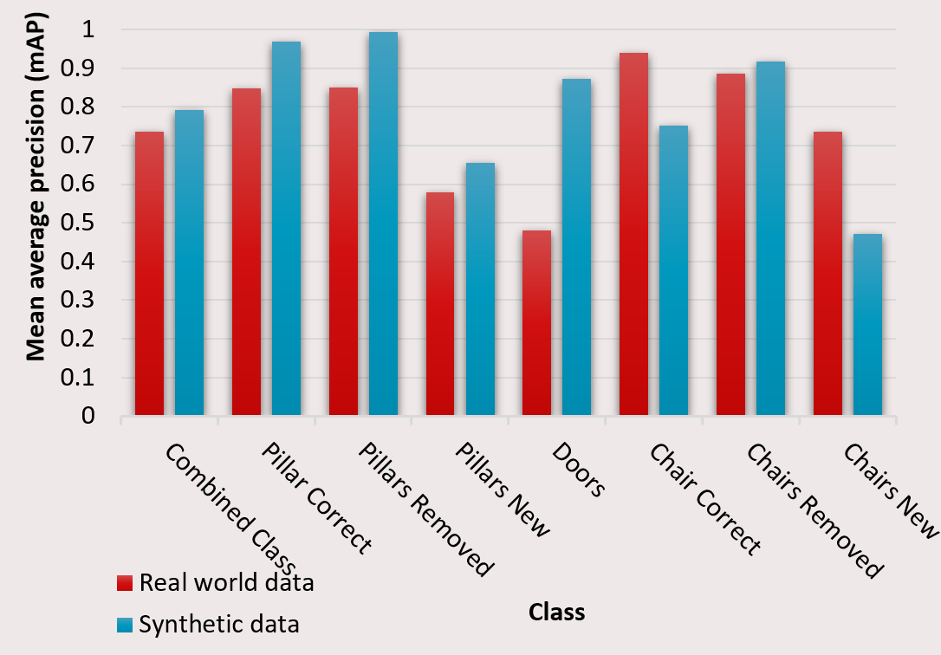
Discussion
Too little information for classification for new objects
Domain gap exists
More real-world test data is needed
Discussion & Conclusion

Slide 25
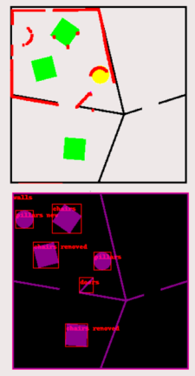
Conclusion
An open-source dataset generator for creating examples of mismatches
Trained a model exclusively on synthetic data
A promising model for updating digital twins from 2D LiDAR data while maintaining semantics!
Future work
More object types
More and varied real world test data
Close the loop
Discussion & Conclusion

Slide 26
Appendix

Slide 27
Overconfident predictions
Chair
LiDAR
You untrustworthy little model?

Slide 28
Detecting areas of overlap
Find areas with overlap (hypothesis area)
Quantify the amount of overlap
Threshold the overlap
These areas are called hypothesis areas
Hypothesis is correct if a predicted label corresponds to ground truth
Overlap Threshold
Intersection
<
=
Union
Hypothesis area
Time for experiments!

Slide 29
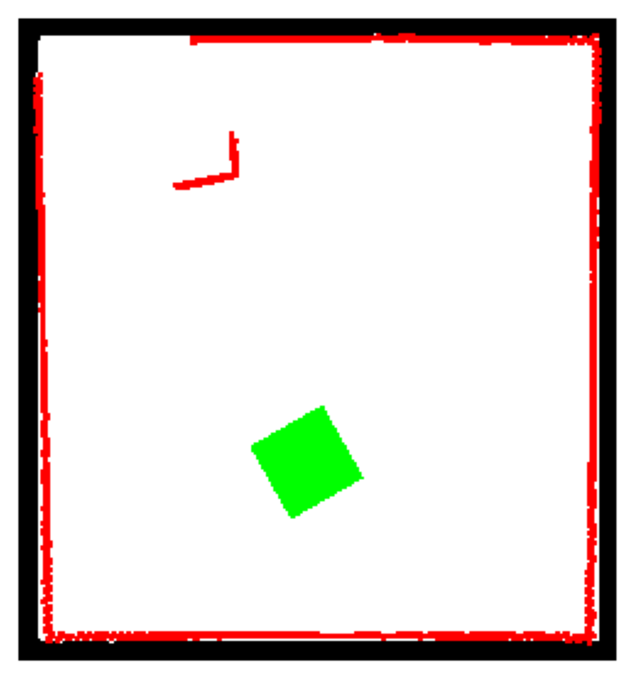
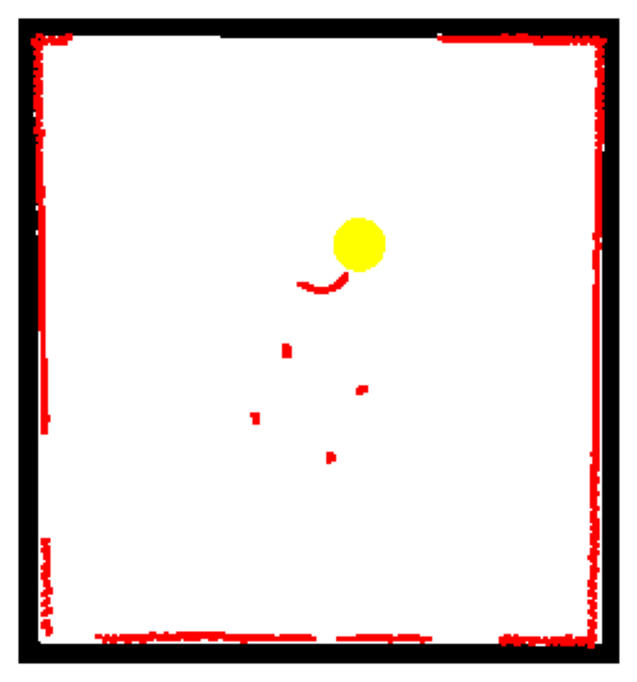
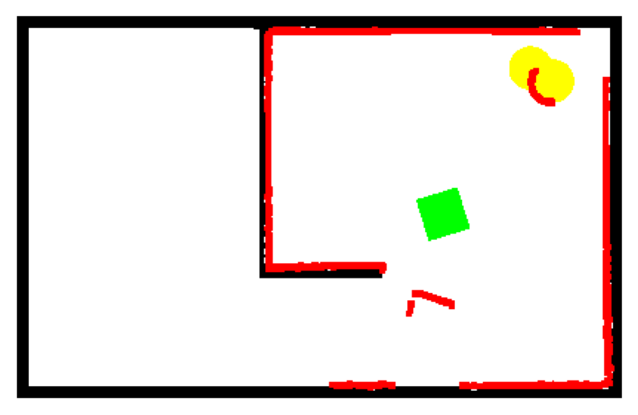
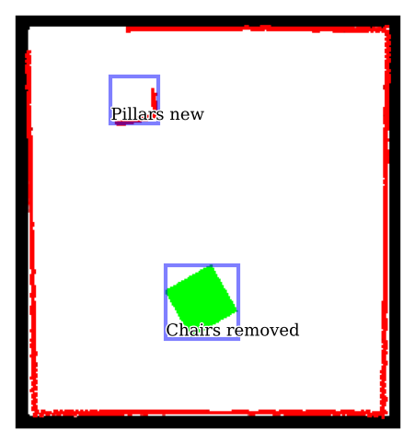
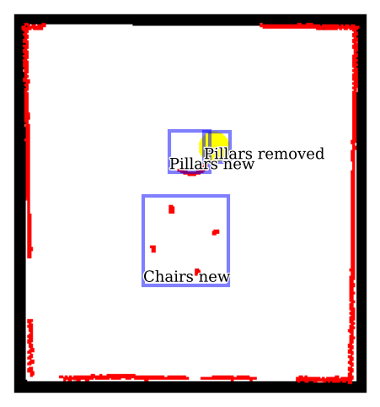
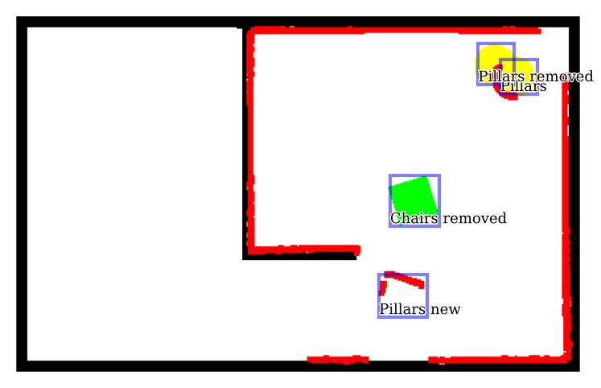
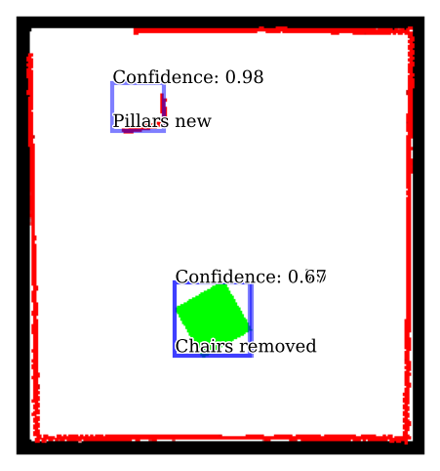
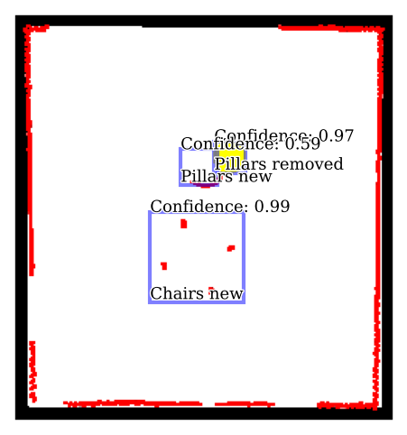
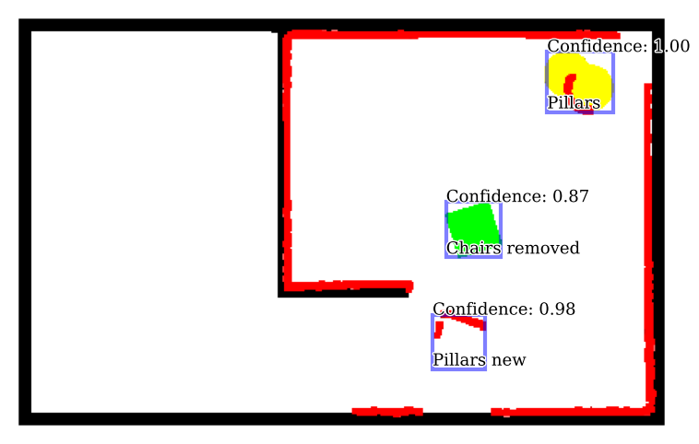
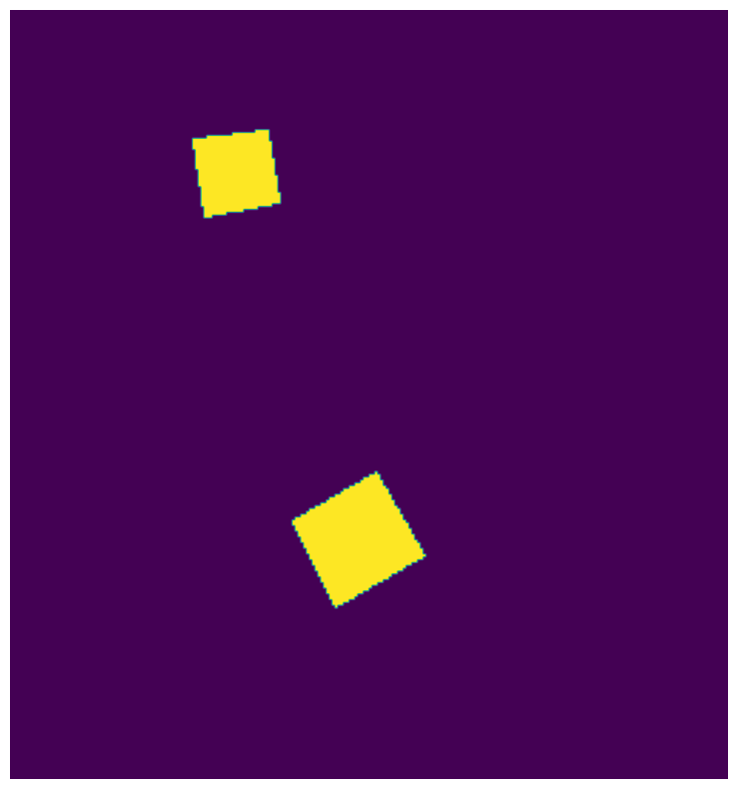


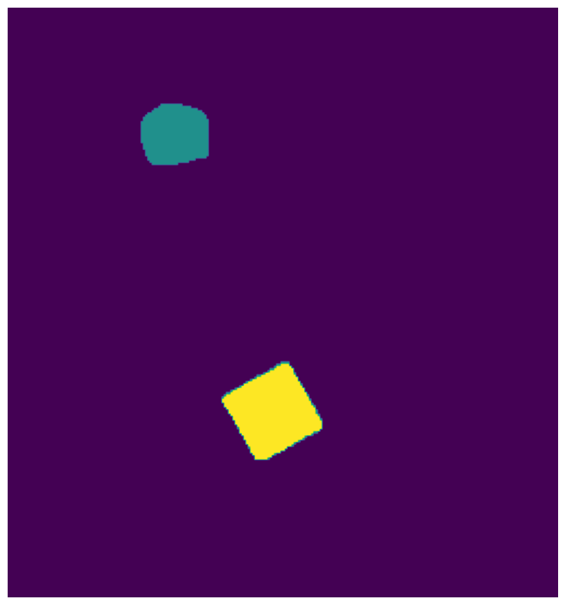

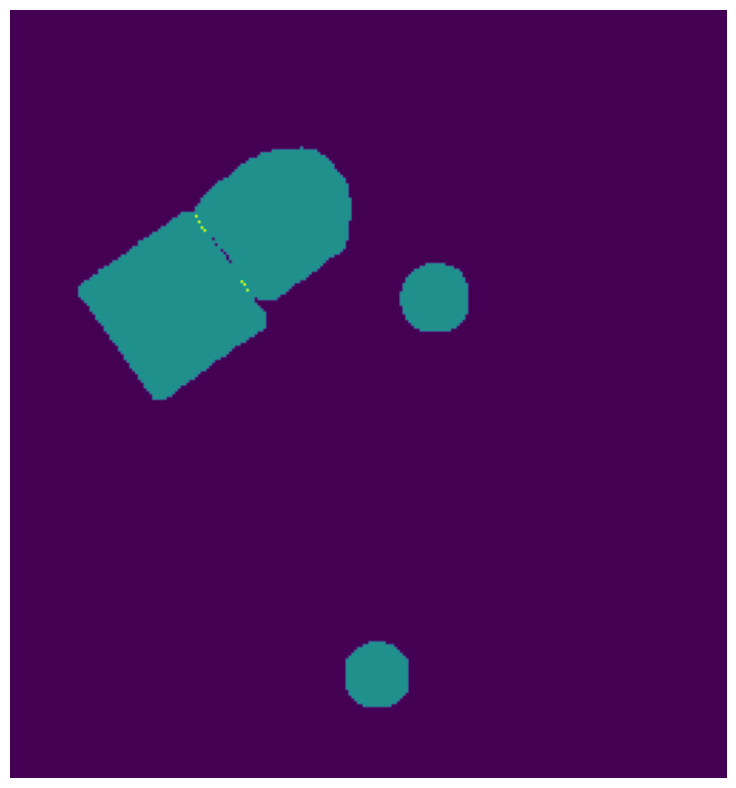

Qualitative Model Performance on real world
Input Image
Bounding Box Ground Truth
Bounding Box Prediction
Masks Truth Ground
Masks prediction
Notes:
It trains!

Slide 30
Experiments
Experiment 3 goal:
Gain insight into data generation parameters
Experiment 3 Methodology:
Ablation experiments
Notes:
Overview slide tussen de verschillende experiment slides

Slide 31
Experiment 3 ResultsmAP Combined Ablation results Bounding Boxes

Slide 32
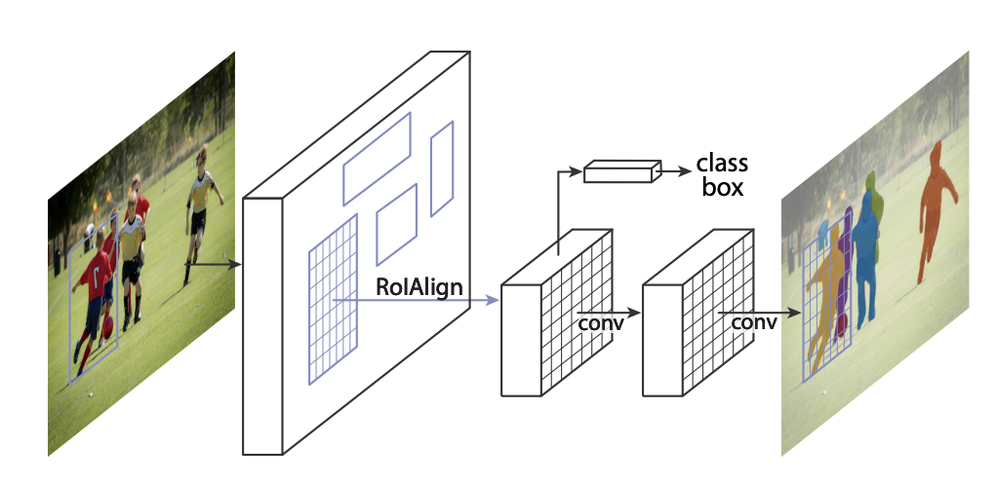
Mask R-CNN

